Slide 1
IMAGE CAPTION GENERATOR

Slide 2
Team MEMBERS
Saikumar Cherku - 700742475
Appalaswamy Yalamanchily - 700747726
Divya Pothuru - 700746292
Sai Vinay Reddy Panala - 700740027

Slide 3
Roles AND RESPONSIBILITIES
Project flow design – Saikumar
Image Data Processing – Divya
VGG16 model implementation – Saikumar, Appalaswamy
Image data feature extraction – Swamy
Captions data analysis – Divya
Captions data feature extraction – Divya
LSTM model Implementation – Vinay
Predicting the captions for images - Vinay
Code review – Appalasawamy
Final Report – Saikumar
Documenting final result – Divya, Vinay

Slide 4
MOTIVATION
Accessibility :
Make visual information accessible to individuals who are visually impaired or blind.
Automation :
Automatically generate captions for large volumes of images, which can be used for a variety of purposes such as marketing, advertising, and social media
Personalization :
More interesting and customized experience for users by fabricating captions based on individual preferences, user-generated content, and other criteria.

Slide 5
OBJECTIVES
It aims to implement an Image caption generator that responds to the user to get the captions for a provided image.
To generate the accurate and informative captions.
To improve the accessibility for visual impaired individuals.
To enhance user experience
To improve machine learning models and enable automation of image analysis.
To enhance the search engine optimization.

Slide 6
RELATED WORK

Slide 7
PROBLEM STATEMENT
Globally there are 2.2 billion people who are visually impaired. They need assistance for reading or checking the information. With the help of deep learning we extract the information from images and process and read it out to the people. Deep learning is a technique which processes the information in the images and translates it into useful information. Deep learning is a subset of machine learning and the models contain three or more layers which extract the information. Image captioning projects deal with understanding the information in the images like humans do, producing the text describing what is happening in the image.

Slide 8
PROPOSED SOLUTION
In this project we propose a combination of networks DNN neural network and LSTM for text classification to generate the meaningful captions. In the end the performance of the test dataset is evaluated using accuracy and BLEU score to check the accuracy of the predictions.

Slide 9
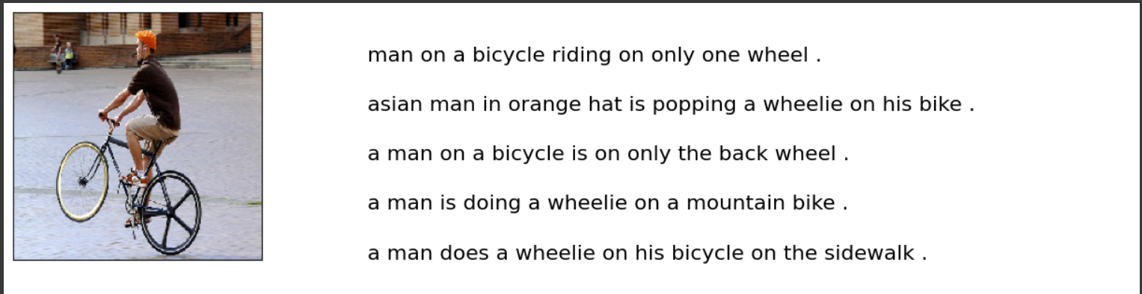
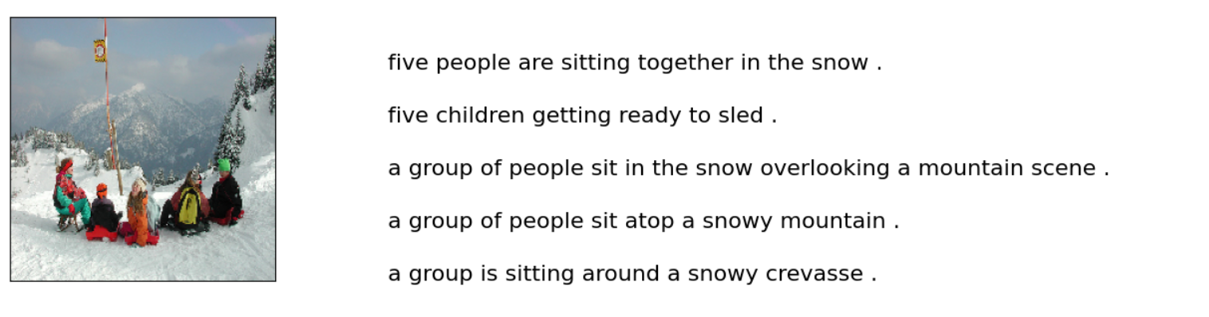
RESULTS/SIMULATIONS

Slide 10
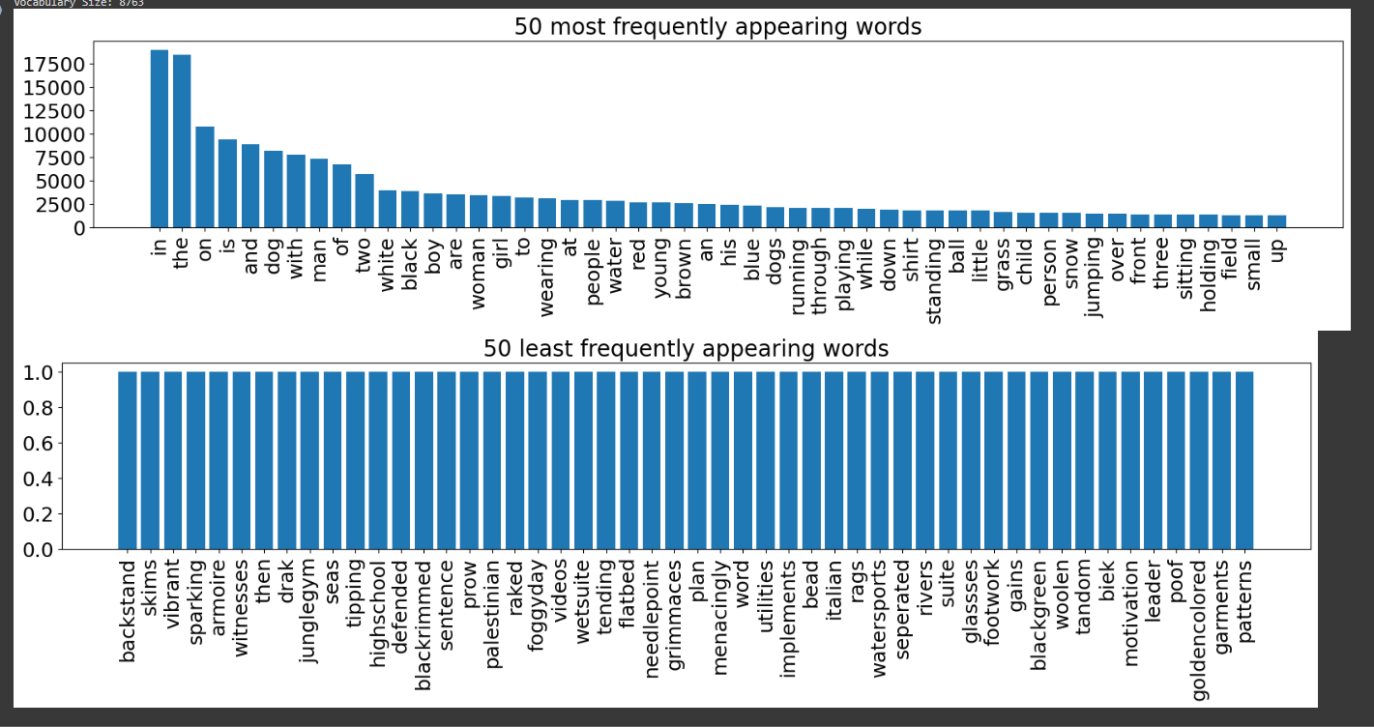

Slide 11
REFERENCES
[1] Jia-Hong Huang, Ting-Wei Wu, Chao-Han Huck Yang, and Marcel Worring. Deep context-encoding network for retinal image captioning. In 2021 IEEE International Conference on Image Processing (ICIP).
[2] Teetouch Jaknamon and Sanparith Marukatat. Thaitc:thai transformerbased image captioning. In 2022 17th International Joint Symposium on Artificial Intelligence and Natural Language Processing (iSAI-NLP).
[3] Apoorva Krisna, Anil Singh Parihar, Aritra Das, and Arnav Aryan. Endto-end model for heavy rain image captioning. In 2022 4th International Conference on Advances in Computing, Communication Control and Networking (ICAC3N).
[4] Xinru Wei, Yonggang Qi, Jun Liu, and Fang Liu. Image retrieval by dense caption reasoning. In 2017 IEEE Visual Communications and Image Processing (VCIP).
[5] Ruchika Malhotra, Tanmay Raj, and Vedika Gupta. Image captioning and identification of dangerous situations using transfer learning. In 2022 6th International Conference on Computing Methodologies and Communication (ICCMC).
[6] Prashant Giridhar Shambharkar, Priyanka Kumari, Pratik Yadav, and Rajat Kumar. Generating caption for image using beam search and analyzation with unsupervised image captioning algorithm. In 2021 5th International Conference on Intelligent Computing and Control Systems (ICICCS).

Slide 12
Thank you!!

